Slide 1
Statistics
Conditional
Probability
Twitter: @Owen134866
www.mathsfreeresourcelibrary.com

Slide 2
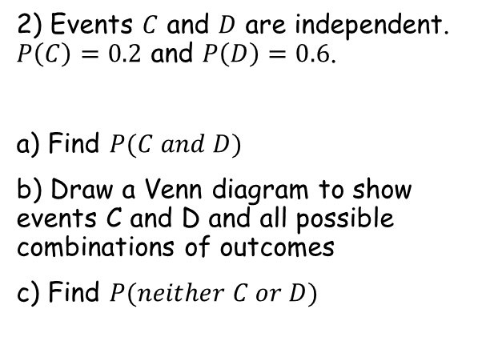
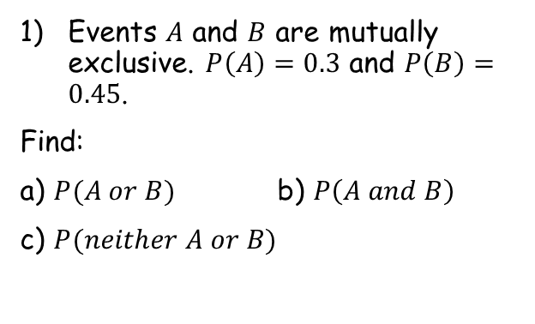


Prior knowledge check
Events $A$ and $B$ are mutually exclusive. $P\left(A\right)=0.3$ and $P\left(B\right)=0.45$.
Find:
a) $P(A or B)$ b) $P\left(A and B\right)$
c) $P(neither A or B)$
3) A bag contains seven counters numbered 1-7. Two counters are selected at random without replacement. Find the probability that:
Both counters are odd-numbered
At least one counter is odd numbered
0.75
0
$$\frac{2}{7}$$
0.25
$$\frac{6}{7}$$
2) Events $C$ and $D$ are independent. $P\left(C\right)=0.2$ and $P\left(D\right)=0.6$.
a) Find $P(C and D)$
b) Draw a Venn diagram to show events C and D and all possible combinations of outcomes
c) Find $P(neither C or D)$
C
D
0.12
0.08
0.12
0.48
0.32
0.32

Slide 3
Teachings for
Exercise 2A

Slide 4



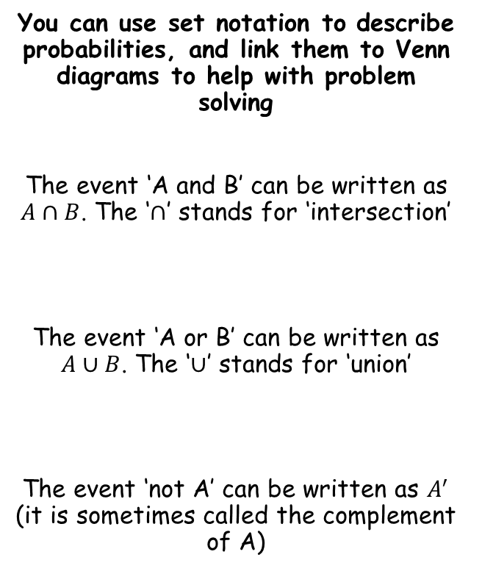






Conditional Probability
You can use set notation to describe probabilities, and link them to Venn diagrams to help with problem solving
The event ‘A and B’ can be written as $A∩B$. The ‘$∩$’ stands for ‘intersection’
The event ‘A or B’ can be written as $A∪B$. The ‘$∪$’ stands for ‘union’
The event ‘not A’ can be written as $A^{′}$ (it is sometimes called the complement of A)
$$A$$
$$B$$
$$A∩B$$
$$A$$
$$B$$
$$A∪B$$
$$A$$
$$B$$
$$A′$$
2A

Slide 5


Conditional Probability
You can use set notation to describe probabilities, and link them to Venn diagrams to help with problem solving
A card is selected at random from a standard pack of playing cards. Let A be the event that the card is an Ace, and D be the event that the card is a diamond.
a) Draw a Venn diagram to represent this information.
$$A$$
$$D$$
3
1
12
36
There is one card that is both an ace and a diamond
There are 3 aces that are not diamonds
There are 12 diamonds that are not aces
After this, 36 cards remain that are neither aces or diamonds
2A

Slide 6


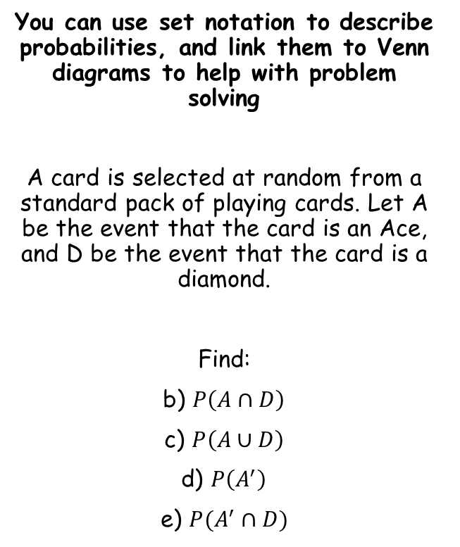





Conditional Probability
You can use set notation to describe probabilities, and link them to Venn diagrams to help with problem solving
A card is selected at random from a standard pack of playing cards. Let A be the event that the card is an Ace, and D be the event that the card is a diamond.
Find:
b) $P\left(A∩D\right)$
c) $P\left(A∪D\right)$
d) $P\left(A^{′}\right)$
e) $P(A^{′}∩D)$
$$A$$
$$D$$
3
1
12
36
‘Probability of the card being an ace and a diamond’
$$=\frac{1}{52}$$
‘Probability of the card being an ace or a diamond’
$$=\frac{16}{52}$$
$$=\frac{4}{13}$$
‘Probability of the card not being an ace’
$$=\frac{48}{52}$$
$$=\frac{12}{13}$$
‘Probability of the card not being an ace, and being a diamond’
$$=\frac{12}{52}$$
$$=\frac{3}{13}$$
2A

Slide 7

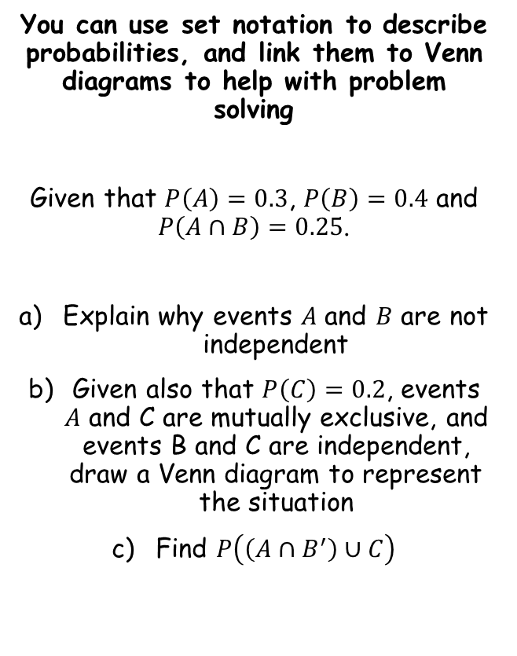
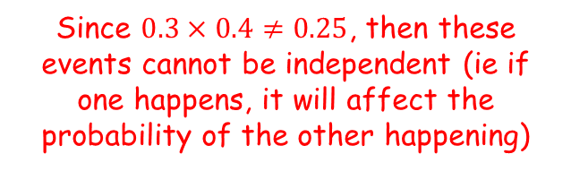
Conditional Probability
You can use set notation to describe probabilities, and link them to Venn diagrams to help with problem solving
Given that $P\left(A\right)=0.3$, $P\left(B\right)=0.4$ and $P\left(A∩B\right)=0.25$.
Explain why events $A$ and $B$ are not independent
Given also that $P\left(C\right)=0.2$, events $A$ and C are mutually exclusive, and events B and C are independent, draw a Venn diagram to represent the situation
Find $P\left(\left(A∩B^{′}\right)∪C\right)$
If the events are independent, then $P\left(A\right)×P\left(B\right)=P(A∩B)$
Since $0.3×0.4≠0.25$, then these events cannot be independent (ie if one happens, it will affect the probability of the other happening)
2A

Slide 8






Conditional Probability
$$B$$
0.43
You can use set notation to describe probabilities, and link them to Venn diagrams to help with problem solving
Given that $P\left(A\right)=0.3$, $P\left(B\right)=0.4$ and $P\left(A∩B\right)=0.25$.
Explain why events $A$ and $B$ are not independent
Given also that $P\left(C\right)=0.2$, events $A$ and C are mutually exclusive, and events B and C are independent, draw a Venn diagram to represent the situation
Find $P\left(\left(A∩B^{′}\right)∪C\right)$
$$A$$
$$C$$
0.05
0.25
0.08
0.12
0.07
→ As $A$ and $C$ are mutually exclusive, they do not overlap
→ $P\left(A∩B\right)=0.25$
Since $P\left(A\right)=0.3$, the probability of only $A$ = 0.05
As $B$ and $C$ are independent, $P\left(B\right)×P\left(C\right)=P(B∩C)$ (0.4x0.2=0.08)
Since $P\left(C\right)=0.2$, the probability of only $C$ = 0.12
Since $P(B)=0.4$, the probability of only $B$ = 0.07
As they must total 1, the probability of none of these must equal 0.43
2A

Slide 9




Conditional Probability
$$B$$
0.43
You can use set notation to describe probabilities, and link them to Venn diagrams to help with problem solving
Given that $P\left(A\right)=0.3$, $P\left(B\right)=0.4$ and $P\left(A∩B\right)=0.25$.
Explain why events $A$ and $B$ are not independent
Given also that $P\left(C\right)=0.2$, events $A$ and C are mutually exclusive, and events B and C are independent, draw a Venn diagram to represent the situation
Find $P\left(\left(A∩B^{′}\right)∪C\right)$
$$A$$
$$C$$
0.05
0.25
0.08
0.12
0.07
$$A∩B^{′}$$
$$C$$
0.05
0.2
$$P\left(\left(A∩B^{′}\right)∪C\right)=0.25$$
The probability of ‘$A$ and not $B$’ or $C$
→ Highlight regions that satisfy each of these parts…
2A

Slide 10
Teachings for
Exercise 2B

Slide 11
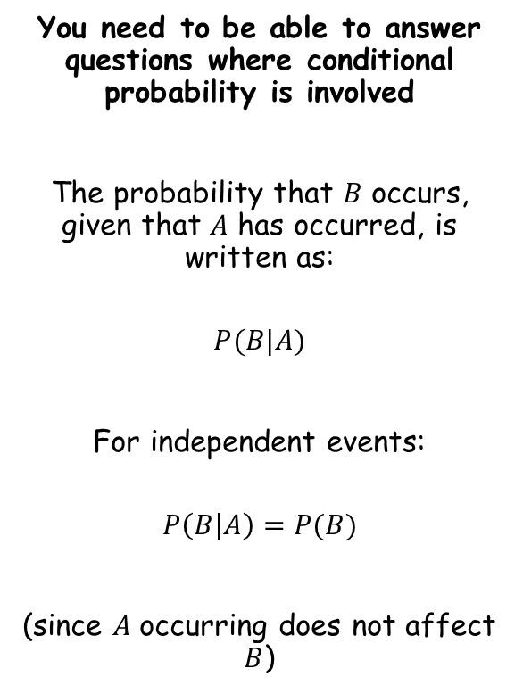
Conditional Probability
You need to be able to answer questions where conditional probability is involved
The probability that $B$ occurs, given that $A$ has occurred, is written as:
$$P(B|A)$$
For independent events:
$$P\left(B | A\right)=P(B)$$
(since $A$ occurring does not affect $B$)
2B

Slide 12
Conditional Probability
You need to be able to answer questions where conditional probability is involved
A school has 75 students in year 12. Of these students, 25 study only humanities subjects (H), and 37 only study science subjects (S). 11 students study both types of subject.
a) Draw a two-way table to show this information
H
H’
Total
S
11
37
48
S’
25
2
27
Total
36
39
75
2B

Slide 13

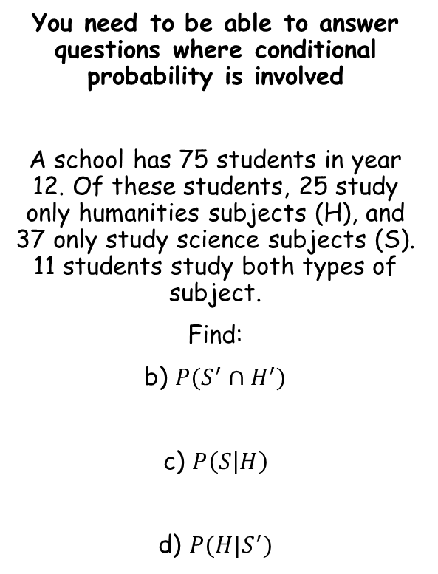
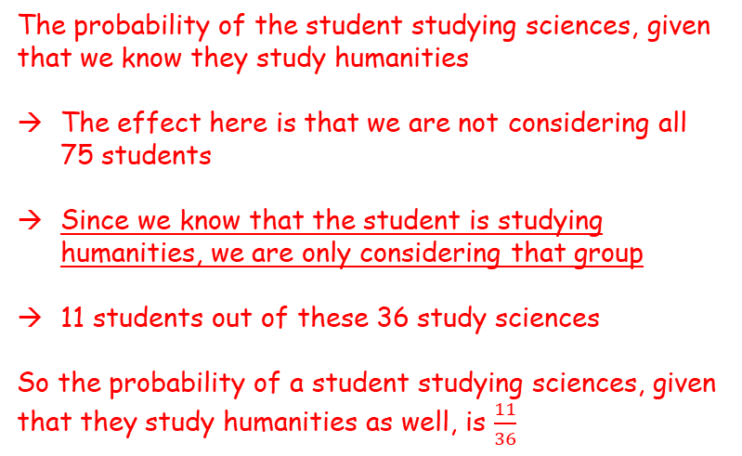
Conditional Probability
You need to be able to answer questions where conditional probability is involved
A school has 75 students in year 12. Of these students, 25 study only humanities subjects (H), and 37 only study science subjects (S). 11 students study both types of subject.
Find:
b) $P(S^{′}∩H^{′})$
c) $P\left(S | H\right)$
d) $P(H|S^{′})$
H
H’
Total
S
11
37
48
S’
25
2
27
Total
36
39
75
The probability of the student studying sciences, given that we know they study humanities
The effect here is that we are not considering all 75 students
Since we know that the student is studying humanities, we are only considering that group
11 students out of these 36 study sciences
So the probability of a student studying sciences, given that they study humanities as well, is $\frac{11}{36}$
$$=\frac{2}{75}$$
2B

Slide 14

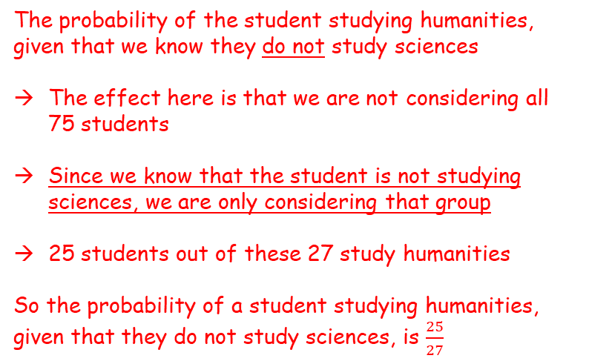
Conditional Probability
You need to be able to answer questions where conditional probability is involved
A school has 75 students in year 12. Of these students, 25 study only humanities subjects (H), and 37 only study science subjects (S). 11 students study both types of subject.
Find:
b) $P(S^{′}∩H^{′})$
c) $P\left(S | H\right)$
d) $P(H|S^{′})$
H
H’
Total
S
11
37
48
S’
25
2
27
Total
36
39
75
The probability of the student studying humanities, given that we know they do not study sciences
The effect here is that we are not considering all 75 students
Since we know that the student is not studying sciences, we are only considering that group
25 students out of these 27 study humanities
So the probability of a student studying humanities, given that they do not study sciences, is $\frac{25}{27}$
$$=\frac{2}{75}$$
$$=\frac{11}{36}$$
2B

Slide 15
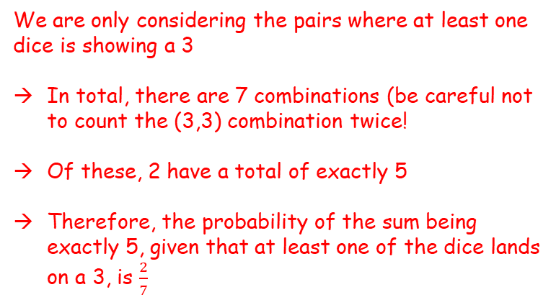
Conditional Probability
Dice 1
You need to be able to answer questions where conditional probability is involved
Two four sided dice are thrown together, and the sum of the numbers shown is recorded.
Draw a sample space diagram showing the possible outcomes
Given that at least one dice lands on a 3, find the probability that the sum of the two dice is exactly 5
 | 1 | 2 | 3 | 4
1 | 2 | 3 | 4 | 5
2 | 3 | 4 | 5 | 6
3 | 4 | 5 | 6 | 7
4 | 5 | 6 | 7 | 8
Dice 2
We are only considering the pairs where at least one dice is showing a 3
In total, there are 7 combinations (be careful not to count the (3,3) combination twice!
Of these, 2 have a total of exactly 5
Therefore, the probability of the sum being exactly 5, given that at least one of the dice lands on a 3, is $\frac{2}{7}$
2B

Slide 16
Conditional Probability
Dice 1
You need to be able to answer questions where conditional probability is involved
Two four sided dice are thrown together, and the sum of the numbers shown is recorded.
c) State one modelling assumption used in your calculations
That both dice are unbiased which means the outcomes are all equally likely
 | 1 | 2 | 3 | 4
1 | 2 | 3 | 4 | 5
2 | 3 | 4 | 5 | 6
3 | 4 | 5 | 6 | 7
4 | 5 | 6 | 7 | 8
Dice 2
2B

Slide 17
Teachings for
Exercise 2C

Slide 18


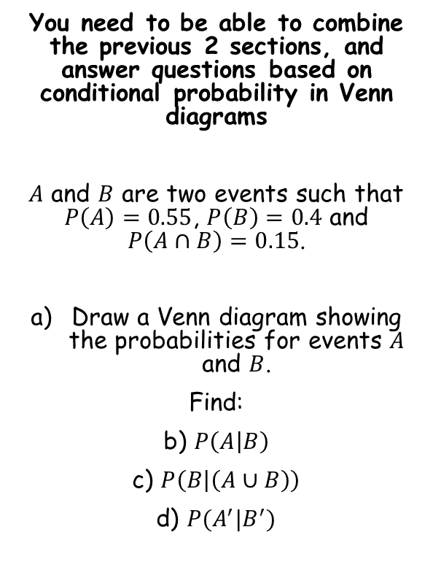
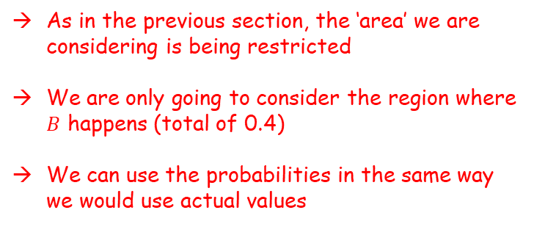


Conditional Probability
You need to be able to combine the previous 2 sections, and answer questions based on conditional probability in Venn diagrams
$A$ and $B$ are two events such that $P\left(A\right)=0.55$, $P\left(B\right)=0.4$ and $P\left(A∩B\right)=0.15$.
Draw a Venn diagram showing the probabilities for events $A$ and $B$.
Find:
b) $P\left(A | B\right)$
c) $P\left(B | \left(A∪B\right)\right)$
d) $P(A^{′}|B^{′})$
$$A$$
$$B$$
0.4
0.15
0.25
0.2
The probability of $A$ happening, given that $B$ happens
As in the previous section, the ‘area’ we are considering is being restricted
We are only going to consider the region where $B$ happens (total of 0.4)
We can use the probabilities in the same way we would use actual values
So the probability of $A$ happening, given that $B$ happens, is $\frac{0.15}{0.4}$
$$=\frac{3}{8}$$
2C

Slide 19


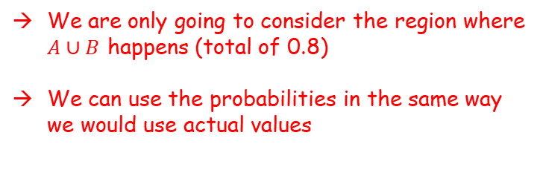


Conditional Probability
You need to be able to combine the previous 2 sections, and answer questions based on conditional probability in Venn diagrams
$A$ and $B$ are two events such that $P\left(A\right)=0.55$, $P\left(B\right)=0.4$ and $P\left(A∩B\right)=0.15$.
Draw a Venn diagram showing the probabilities for events $A$ and $B$.
Find:
b) $P\left(A | B\right)$
c) $P\left(B | \left(A∪B\right)\right)$
d) $P(A^{′}|B^{′})$
$$A$$
$$B$$
0.4
0.15
0.25
0.2
The probability of $B$ happening, given that $A$ or $B$ happens
We are only going to consider the region where $A∪B$ happens (total of 0.8)
We can use the probabilities in the same way we would use actual values
$$\frac{3}{8}$$
So the probability of $B$ happening, given that $B$ happens, is $\frac{0.4}{0.8}$
$$=\frac{1}{2}$$
2C

Slide 20


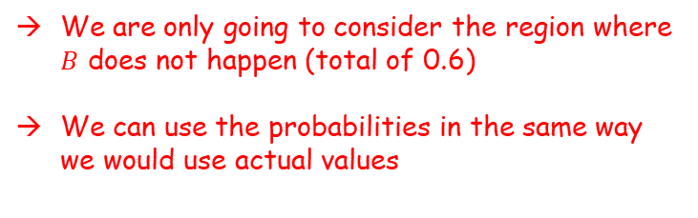


Conditional Probability
You need to be able to combine the previous 2 sections, and answer questions based on conditional probability in Venn diagrams
$A$ and $B$ are two events such that $P\left(A\right)=0.55$, $P\left(B\right)=0.4$ and $P\left(A∩B\right)=0.15$.
Draw a Venn diagram showing the probabilities for events $A$ and $B$.
Find:
b) $P\left(A | B\right)$
c) $P\left(B | \left(A∪B\right)\right)$
d) $P(A^{′}|B^{′})$
$$A$$
$$B$$
0.4
0.15
0.25
0.2
The probability of $A$ not happening, given that $B$ does not happen
We are only going to consider the region where $B$ does not happen (total of 0.6)
We can use the probabilities in the same way we would use actual values
$$\frac{3}{8}$$
$$\frac{1}{2}$$
So the probability of $A$ not happening, given that $B$ does not happen, is $\frac{0.2}{0.6}$
$$=\frac{1}{3}$$
2C

Slide 21
Teachings for
Exercise 2D

Slide 22





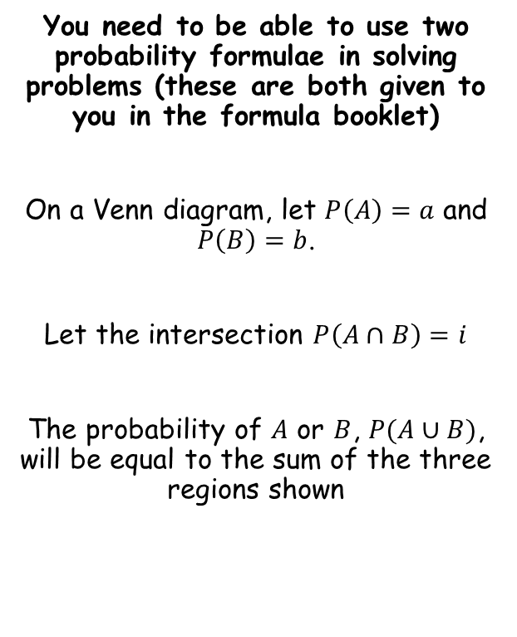








Conditional Probability
$$P\left(A∪B\right)=P\left(A\right)+P\left(B\right)−P(A∩B)$$
You need to be able to use two probability formulae in solving problems (these are both given to you in the formula booklet)
On a Venn diagram, let $P\left(A\right)=a$ and $P\left(B\right)=b$.
Let the intersection $P\left(A∩B\right)=i$
The probability of $A$ or $B$, $P(A∪B)$, will be equal to the sum of the three regions shown
$$A$$
$$B$$
$$a−i$$
$$i$$
$$b−i$$
$$P\left(A∪B\right)=$$
$$a−i$$
$$+ i$$
$$+ b−i$$
Simplify
Replace each term using the information in the question
$$P\left(A∪B\right)=$$
$$a+b−i$$
$$P\left(A∪B\right)=$$
$$P\left(A\right)+P\left(B\right)−P(A∩B)$$
Note that for mutually exclusive events, $P\left(A∩B\right)=0$, so:
$P\left(A∪B\right)=$ $P\left(A\right)+P\left(B\right)$
2D

Slide 23




Conditional Probability
$$P\left(A∪B\right)=P\left(A\right)+P\left(B\right)−P(A∩B)$$
You need to be able to use two probability formulae in solving problems (these are both given to you in the formula booklet)
A and B are two events, such that $P\left(A\right)=0.6$, $P\left(B\right)=0.7$ and $P\left(A∪B\right)=0.9$. Find $P(A∩B)$.
$$P\left(A∪B\right)=P\left(A\right)+P\left(B\right)−P(A∩B)$$
Sub in values from the question
$$0.9=0.6+0.7−P(A∩B)$$
Simplify
$$0.9=1.3−P(A∩B)$$
Calculate
$$P(A∩B)=0.4$$
2D

Slide 24



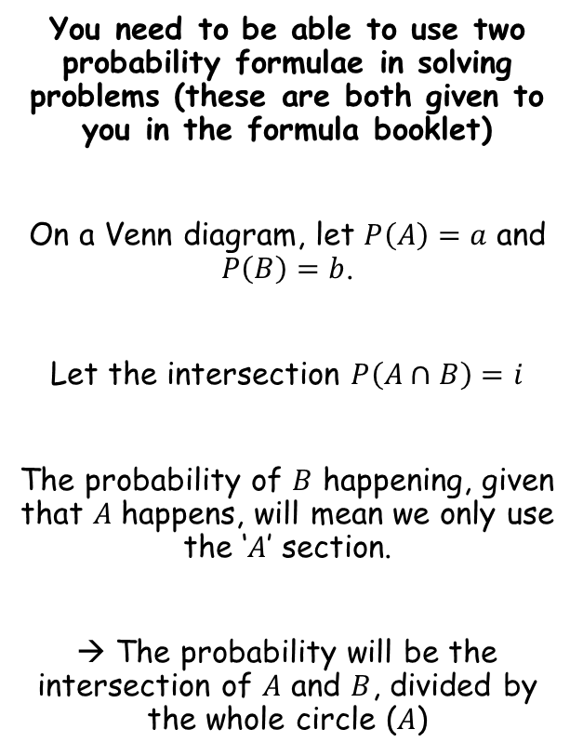







Conditional Probability
$$P\left(A∪B\right)=P\left(A\right)+P\left(B\right)−P(A∩B)$$
$$P\left(A∩B\right)=P(A)P\left(B | A\right)$$
You need to be able to use two probability formulae in solving problems (these are both given to you in the formula booklet)
On a Venn diagram, let $P\left(A\right)=a$ and $P\left(B\right)=b$.
Let the intersection $P\left(A∩B\right)=i$
The probability of $B$ happening, given that $A$ happens, will mean we only use the ‘$A$’ section.
→ The probability will be the intersection of $A$ and $B$, divided by the whole circle ($A$)
$$A$$
$$B$$
$$a−i$$
$$i$$
$$b−i$$
$$P\left(B | A\right)=$$
$$i$$
$$a−i+i$$
Simplify
$$\frac{i}{a}$$
$$P\left(B | A\right)=$$
Replace using the information in the question
$$\frac{P(A∩B)}{P(A)}$$
$$P\left(B | A\right)=$$
Multiply by P(A)
$$P(A)P\left(B | A\right)=$$
$$P(A∩B)$$
This is the form you are given in the formula booklet
$$P\left(A∩B\right)=P(A)P\left(B | A\right)$$
2D

Slide 25
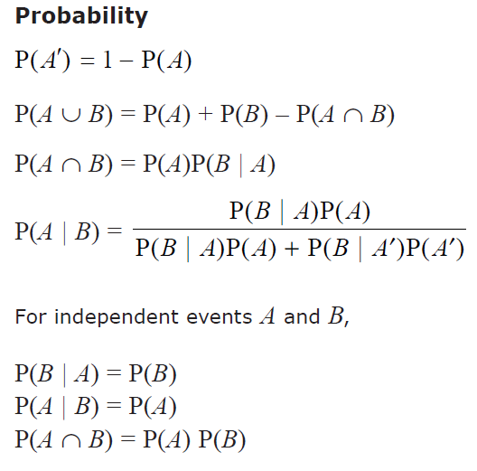
Conditional Probability
$$P\left(A∪B\right)=P\left(A\right)+P\left(B\right)−P(A∩B)$$
$$P\left(A∩B\right)=P(A)P\left(B | A\right)$$
2D

Slide 26




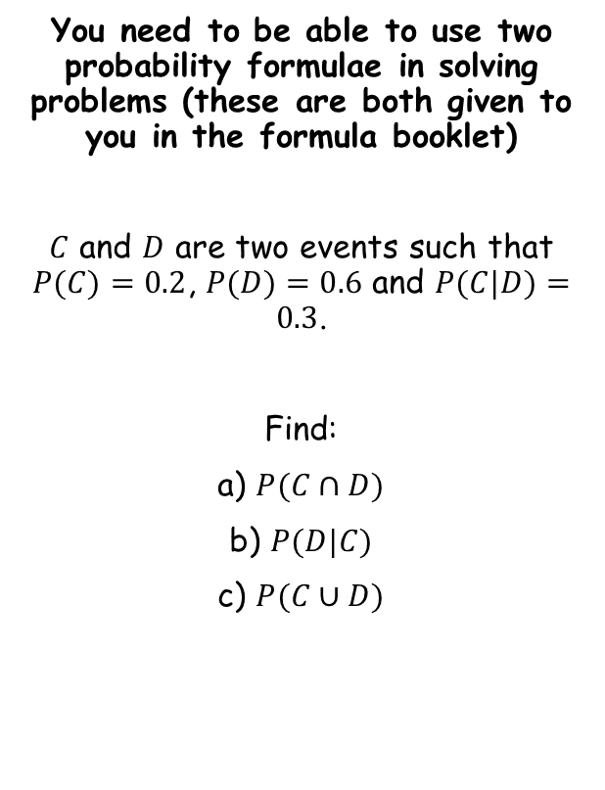







Conditional Probability
$$P\left(A∪B\right)=P\left(A\right)+P\left(B\right)−P(A∩B)$$
$$P\left(A∩B\right)=P(A)P\left(B | A\right)$$
You need to be able to use two probability formulae in solving problems (these are both given to you in the formula booklet)
$C$ and $D$ are two events such that $P(C)=0.2$, $P(D)=0.6$ and $P(C|D)=0.3$.
Find:
a) $P(C∩D)$
b) $P(D|C)$
c) $P(C∪D)$
$$P\left(A∩B\right)=P(A)P\left(B | A\right)$$
Replace $A$ with $C$, and $B$ with $D$
$$P\left(C∩D\right)=P(C)P\left(D | C\right)$$
Note that there is a problem here – we do not know $P(D|C)$ yet…
However, since $P\left(C∩D\right)=P(D∩C)$, we can swap all the $C$s and $D$s around…
$$P\left(C∩D\right)=P(C)P\left(D | C\right)$$
Swap $C$ and $D$s around…
$$=0.18$$
$$P\left(D∩C\right)=P(D)P\left(C | D\right)$$
Sub in values
$$P\left(D∩C\right)=0.6×0.3$$
Calculate
$$P\left(D∩C\right)=0.18$$
2D

Slide 27



Conditional Probability
$$P\left(A∪B\right)=P\left(A\right)+P\left(B\right)−P(A∩B)$$
$$P\left(A∩B\right)=P(A)P\left(B | A\right)$$
You need to be able to use two probability formulae in solving problems (these are both given to you in the formula booklet)
$C$ and $D$ are two events such that $P(C)=0.2$, $P(D)=0.6$ and $P(C|D)=0.3$.
Find:
a) $P(C∩D)$
b) $P(D|C)$
c) $P(C∪D)$
$$P\left(A∩B\right)=P(A)P\left(B | A\right)$$
Replace $A$ with $C$, and $B$ with $D$
$$P\left(C∩D\right)=P(C)P\left(D | C\right)$$
Sub in values (using the answer from a)
$$0.18=0.2×P\left(D | C\right)$$
Divide by 0.2
$$0.9=P\left(D | C\right)$$
$$=0.18$$
$$=0.9$$
2D

Slide 28



Conditional Probability
$$P\left(A∪B\right)=P\left(A\right)+P\left(B\right)−P(A∩B)$$
$$P\left(A∩B\right)=P(A)P\left(B | A\right)$$
You need to be able to use two probability formulae in solving problems (these are both given to you in the formula booklet)
$C$ and $D$ are two events such that $P(C)=0.2$, $P(D)=0.6$ and $P(C|D)=0.3$.
Find:
a) $P(C∩D)$
b) $P(D|C)$
c) $P(C∪D)$
$$P\left(A∪B\right)=P\left(A\right)+P\left(B\right)−P(A∩B)$$
Replace $A$ with $C$, and $B$ with $D$
$$P\left(C∪D\right)=P\left(C\right)+P\left(D\right)−P(C∩D)$$
Sub in values
$$P\left(C∪D\right)=0.2+0.6−0.18$$
Calculate
$$P\left(C∪D\right)=0.62$$
$$=0.18$$
$$=0.9$$
2D

Slide 29
Teachings for
Exercise 2E

Slide 30













Conditional Probability
$$P\left(A∪B\right)=P\left(A\right)+P\left(B\right)−P(A∩B)$$
$$P\left(A∩B\right)=P(A)P\left(B | A\right)$$
You need to be able to use tree diagrams with conditional probabilities
You will have encountered tree diagrams before. Suppose we are considering events A and B…
So the probability of A and B happening will be given by multiplying the probabilities along its ‘route’
→ This leads to the formula you learnt in the previous section…
$$B$$
$$P\left(A∩B\right)=P(A)P\left(B | A\right)$$
$$P(B|A)$$
$$P(A)$$
$$A$$
$$P(B′|A)$$
$$B′$$
$$P(B|A′)$$
$$B$$
$$P(A′)$$
$$A′$$
$$P(B′|A′)$$
$$B′$$
2E

Slide 31

















Conditional Probability
$$P\left(A∪B\right)=P\left(A\right)+P\left(B\right)−P(A∩B)$$
$$P\left(A∩B\right)=P(A)P\left(B | A\right)$$
$$\frac{5}{9}$$
$$G$$
You need to be able to use tree diagrams with conditional probabilities
A bag contains 6 green beads and 4 yellow beads. A bead is taken from the bag at random, the colour is recorded and it is not replaced. A second bead is then taken from the bag and its colour recorded. Given that both balls are the same colour, find the probability that they are both yellow.
Start by drawing a tree diagram…
$$\frac{6}{10}$$
$$G$$
$$\frac{4}{9}$$
$$Y$$
$$\frac{6}{9}$$
$$G$$
$$\frac{4}{10}$$
$$Y$$
$$\frac{3}{9}$$
$$Y$$
$$P\left(A∩B\right)=P(A)P\left(B | A\right)$$
Rearrange
$$P\left(B | A\right)=\frac{P\left(A∩B\right)}{P(A)}$$
Use the notation to the left
$$P\left(YY | S \right)=\frac{P(YY∩S)}{P(S)}$$
Let ‘$both yellow$’ = $YY$
So the probability of getting both yellow, given that both are the same, is equal to the calculation indicated…
Let ‘$both same$’ = $S$
2E

Slide 32


Conditional Probability
$$P\left(A∪B\right)=P\left(A\right)+P\left(B\right)−P(A∩B)$$
$$P\left(A∩B\right)=P(A)P\left(B | A\right)$$
$$\frac{5}{9}$$
$$G$$
You need to be able to use tree diagrams with conditional probabilities
A bag contains 6 green beads and 4 yellow beads. A bead is taken from the bag at random, the colour is recorded and it is not replaced. A second bead is then taken from the bag and its colour recorded. Given that both balls are the same colour, find the probability that they are both yellow.
Start by drawing a tree diagram…
$$\frac{6}{10}$$
$$G$$
$$\frac{4}{9}$$
$$Y$$
$$\frac{6}{9}$$
$$G$$
$$\frac{4}{10}$$
$$Y$$
$$\frac{3}{9}$$
$$Y$$
$$P\left(YY | S \right)=\frac{P(YY)}{P(S)}$$
$$P\left(YY | S \right)=\frac{P(YY∩S)}{P(S)}$$
→ The probability of getting ‘both yellow’ and ‘both same’ is equal to ‘both yellow’ (since if they are both yellow, they will also be both the same)
Let ‘$both yellow$’ = $YY$
→ The probability of both being the same will be the probability of getting both yellow, plus the probability of getting both green…
Let ‘$both same$’ = $S$
2E

Slide 33

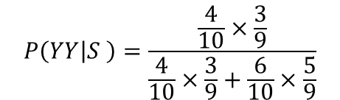
Conditional Probability
$$P\left(A∪B\right)=P\left(A\right)+P\left(B\right)−P(A∩B)$$
$$P\left(A∩B\right)=P(A)P\left(B | A\right)$$
$$\frac{5}{9}$$
$$G$$
You need to be able to use tree diagrams with conditional probabilities
A bag contains 6 green beads and 4 yellow beads. A bead is taken from the bag at random, the colour is recorded and it is not replaced. A second bead is then taken from the bag and its colour recorded. Given that both balls are the same colour, find the probability that they are both yellow.
Start by drawing a tree diagram…
$$\frac{6}{10}$$
$$G$$
$$\frac{4}{9}$$
$$Y$$
$$\frac{6}{9}$$
$$G$$
$$\frac{4}{10}$$
$$Y$$
$$\frac{3}{9}$$
$$Y$$
$$P\left(YY | S \right)=\frac{P(YY)}{P(S)}$$
Sub in the calculations we mentioned on the previous slide
$$P\left(YY | S \right)=\frac{\frac{4}{10}×\frac{3}{9}}{\frac{4}{10}×\frac{3}{9}+\frac{6}{10}×\frac{5}{9}}$$
Let ‘$both yellow$’ = $YY$
Calculate
Let ‘$both same$’ = $S$
$$P\left(YY | S \right)=\frac{2}{7}$$
2E

